Slide 1
WarpMap:Accurate and Efficient Indoor Location by Dynamic Warping in Sequence-Type Radio-map
Xuehan Ye, Yongcai Wang,
Wei Hu, Lei Song, Zhaoquan Gu, Deying Li

Slide 2
Offline Training Phase

Slide 3
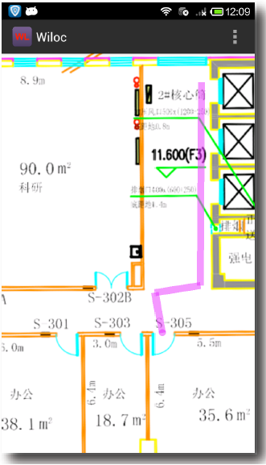
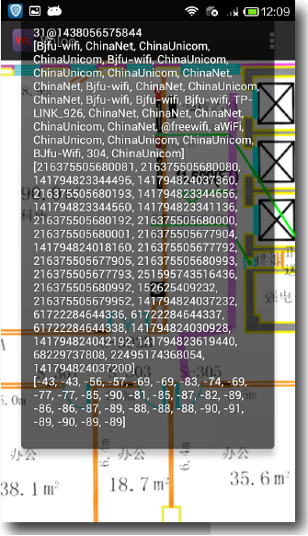
RSS Sequence Collection
Mark the path.
Walk along the specified path to collect RSS sequence.

Slide 4
Collaborative Filter
This process repeats a
fixed number of times
 | Time1 | Time2 | Time3
AP1 | -85 |  | -89
AP2 | -80 | -80
AP3 |  | -86 | -84
AP4 | -90 | -88 | -88
 | Time1 | Time2 | Time3
AP1 | -85 | -87 | -89
AP2 | -80 | -80
AP3 |  | -86 | -84
AP4 | -90 | -88 | -88
 | Time1 | Time2 | Time3
AP1 | -85 | -83 | -89
AP2 | -80 | -80
AP3 |  | -86 | -84
AP4 | -90 | -88 | -88
 | Time1 | Time2 | Time3
AP1 | -85 |  | -89
AP2 | -80 | -80
AP3 |  | -86 | -84
AP4 | -90 | -88 | -88
|-87-(-83)|<T
Avg
-85
Want to predict unknow data.
First, the missing value is predicted by polynomial fitting over time.
Then, the missing value is predicted by a weighted interpolation
based on the APs' RSS sequence similarity.
If two predicted values have difference smaller than a threshold, the
average value will be filled.

Slide 5
WarpMap Generation
v1
1
e1
path segment 1
4
2
4
2
3
3
Train two paths.
Training paths are split by intersections.
A WarpMap is represented by
G=(V,E), where V represents RSS signatures on path
segments and E represents adjacency of path segments.

Slide 6
Online Locating Phase

Slide 7
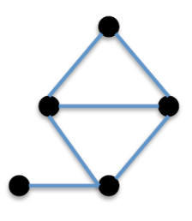
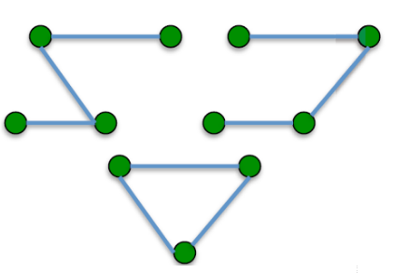
Candidate Sequence Set Generation
Get trace-graph WarpMap.
Green vertexes have AP
list similar with that in the
moving window are added
to candidate vertex set (CVS).
Candidate paths of length
3 are generated from CVS
to form candidate sequence set (CSS).

Slide 8
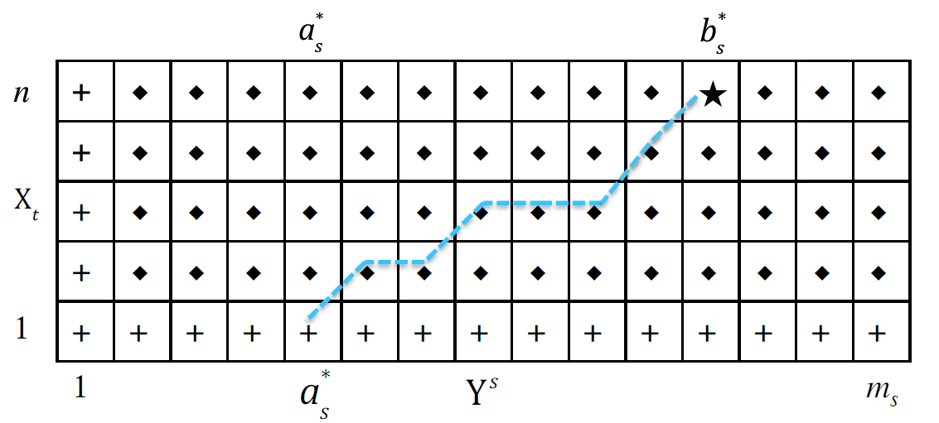
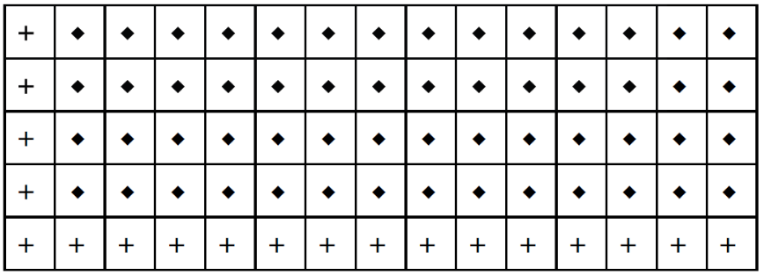
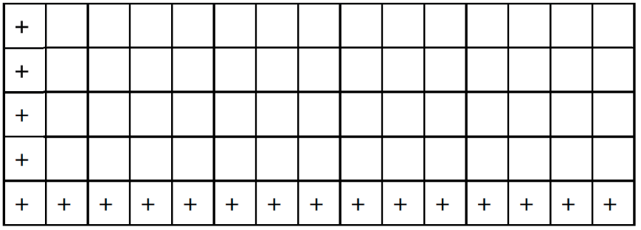
Subsequence Dynamic Time Warping
Then the warping distance matrix is produced as:
Set the boundary conditions of warping distance matrix::
The matched end point between Xt and Y^{s} is determined by D_{s}:
Xt: one sequence in collected online moving window
Y^{s}: one sequence in CSS

Slide 9
More details: ycw@ruc.edu.cn

